Slide 1
Basic Data structure

Slide 2

Basic Data Structure
Basic Data Structures
Linear Data Structures
Non-Linear Data Structures
Arrays
Linked Lists
Stacks
Queues
Trees
Graphs
Hash Tables

Slide 3
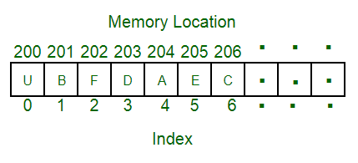
Array
array
An array is a collection of data items, all of the same type, accessed using a common name.
A one-dimensional array(1D) is like a list.
A two dimensional array (2D)is like a table.
The C language places no limits on the number of dimensions in an array.

Slide 4
One-Dimensional (1-D) Array
1 | 2 | 3 | 4 | 5 | 6 | 7 | 8 | 9 | 0
1 | 2
3 | 4
1 | 2 | 3
4 | 5 | 6
7 | 8 | 9
Two-Dimensional (2-D) Array
Three-Dimensional (3-D) Array

Slide 5
Finding the number of elements in an array
Starting address of an array= Lower Bound (LB)
Higher Index -1= Upper Bound (UB)
No. of Elements= UB-LB+1
Int A[10]
No. of Elements: 9-0+1= 10

Slide 6
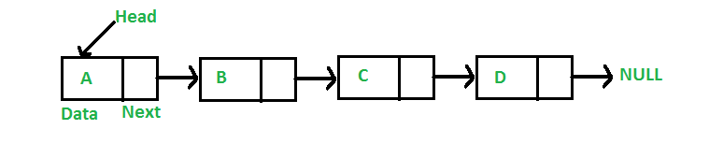
Linked List
Linked list
In computer science, a linked list is a linear collection of data elements whose order is not given by their physical placement in memory.
Instead, each element points to the next. It is a data structure consisting of a collection of nodes which together represent a sequence

Slide 7
Array VS Linked List
An array is the data structure that contains a collection of similar type data elements whereas the Linked list is considered as non-primitive data structure contains a collection of unordered linked elements known as nodes.
Elements are stored consecutively in arrays whereas it is stored randomly in Linked lists.
Accessing an element in an array is fast, while Linked list takes linear time, so it is quite a bit slower.
Operations like insertion and deletion in arrays consume a lot of time. On the other hand, the performance of these operations in Linked lists is fast.
Arrays are of fixed size. In contrast, Linked lists are dynamic and flexible and can expand and contract its size.
In an array, memory is assigned during compile time while in a Linked list it is allocated during execution or runtime.

Slide 8
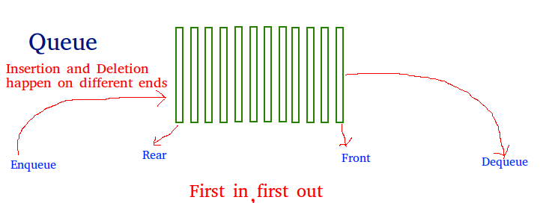
Queue
Queue
A Queue is a linear structure which follows a particular order in which the operations are performed. The order is First In First Out (FIFO).
A good example of a queue is any queue of consumers for a resource where the consumer that came first is served first.

Slide 9
Operations on Queue:
Mainly the following four basic operations are performed on queue:
Enqueue: Adds an item to the queue. If the queue is full, then it is said to be an Overflow condition.
Dequeue: Removes an item from the queue. The items are popped in the same order in which they are pushed. If the queue is empty, then it is said to be an Underflow condition.
Front: Get the front item from queue.
Rear: Get the last item from queue.

Slide 10
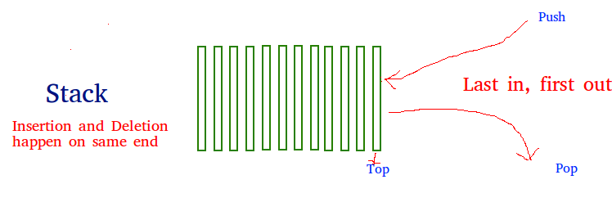
Stack
stack
Stack is a linear data structure which follows a particular order in which the operations are performed.
The order may be LIFO(Last In First Out) or FILO(First In Last Out).

Slide 11
Operations on stack
Mainly the following three basic operations are performed in the stack:
Push: Adds an item in the stack. If the stack is full, then it is said to be an Overflow condition.
Pop: Removes an item from the stack. The items are popped in the reversed order in which they are pushed. If the stack is empty, then it is said to be an Underflow condition.
Peek or Top: Returns top element of stack.
isEmpty: Returns true if stack is empty, else false.

Slide 12
Difference between stack and queue
The difference between stacks and queues is in removing.
In a stack we remove the item the most recently added.
In a queue, we remove the item the least recently added.

Slide 13
Non- Linear Data Structure

Slide 14
Tree
tree
A tree is a nonlinear data structure, compared to arrays, linked lists, stacks and queues which are linear data structures.
A tree can be empty with no nodes or a tree is a structure consisting of one node called the root and zero or one or more subtrees.

Slide 15
Why Trees?
1. One reason to use trees might be because you want to store information that
naturally forms a hierarchy.
2. Trees (with some ordering e.g., BST) provide moderate access/search (quicker than Linked List and slower than arrays).
3. Trees provide moderate insertion/deletion (quicker than Arrays and slower than Unordered Linked Lists).
4. Like Linked Lists and unlike Arrays, Trees don’t have an upper limit on number of nodes as nodes are linked using pointers.

Slide 16
Binary Tree
A tree whose elements have at most 2 children is called a binary tree. Since each element in a binary tree can have only 2 children, we typically name them the left and right child.
Binary Tree Representation in C: A tree is represented by a pointer to the topmost node in tree. If the tree is empty, then value of root is NULL.
A Tree node contains following parts.
1. Data
2. Pointer to left child
3. Pointer to right child
file system
-----------
/ <-- root
/ \
... home
/ \
ugrad course
/ / | \
... cs101 cs112 cs113

Slide 17
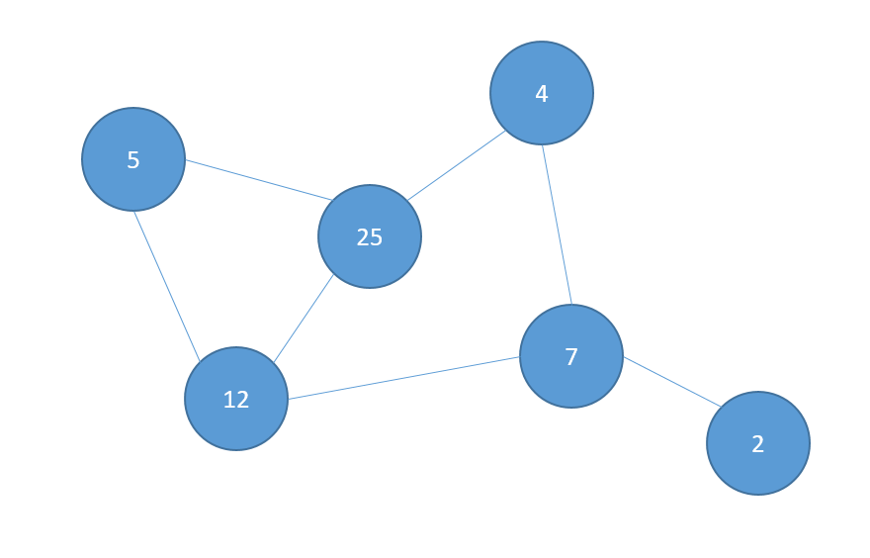
Graph
A Graph is a non-linear data structure consisting of nodes and edges.
The nodes are sometimes also referred to as vertices and the edges are lines or arcs that connect any two nodes in the graph.

Slide 18
Hash Table
Hash Table is a data structure which stores data in an associative manner. In a hash table, data is stored in an array format, where each data value has its own unique index value.
Access of data becomes very fast if we know the index of the desired data.
Hash Table uses an array as a storage medium and uses hash technique to generate an index where an element is to be inserted or is to be located from.

Slide 19
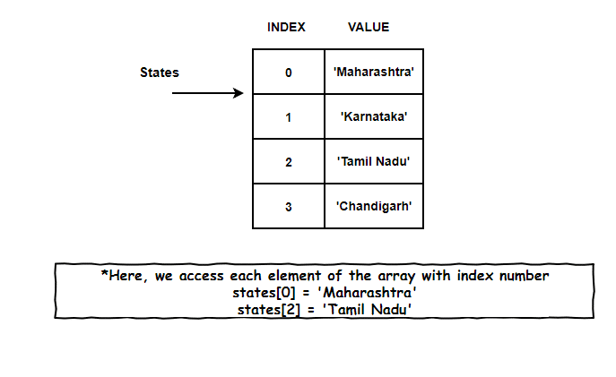
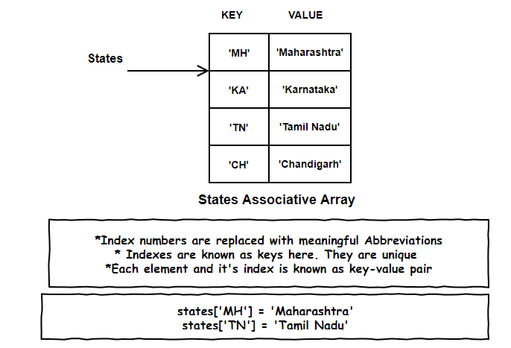
Hash Table

Slide 20
Selection of Data Structure
The choice of particular data model depends on two consideration:
  It must be rich enough in structure to represent the relationship between data elements
  The structure should be simple enough that one can effectively process the data when necessary

Slide 21
Type of Data Structures
Homogenous: In this type of data structures, values of the same types of data are stored.
  Array
Non-Homogenous: In this type of data structures, data values of different types are grouped and stored.
  Structures
  Classes

Slide 22
OPERATIONS ON ARRAYS
Various operations that can be performed on an array
Traversing
Insertion
Deletion
Sorting
Searching
Merging

Slide 23
Traversing Linear Array:
Let A be a collection of data elements stored in the memory of the computer.
Suppose we want to print the content of each element of A or suppose we want to count the number of elements of A, this can be accomplished by traversing A, that is, by accessing and processing each element of a exactly ones.

Slide 24
The following algorithm traverses a linear array LA. The simplicity of the algorithm comes from the fact that LA is a linear structure.
Algorithm: (Traversing a Linear Array) Here LA is a linear array with lower bound LB and upper bound UB. This algorithm traverses LA applying an operation PROCESS to each element of LA.
1. [Initialize counter] Set k: =LB.
2. Repeat steps 3 and 4 while k <=UB.
3. [Visit Element] Apply PROCESS to LA [k].
4. [Increase Counter] Set k: =k + 1.
[End of step 2 loop]
5. Exit.
1
2
3
4
L.B
U.B

Slide 25
Insertion and Deletion in Linear Array:
Let A be a collection of data elements in the memory of the computer.
“Inserting "refers to the operation of adding another element to the collection A
“Deleting” refers to the operation of removing one element from A.

Slide 26
Insertion in Linear Array:
Inserting an element at the end of the linear array can be easily done provided the memory space allocated for the array is large enough to accommodate the additional element.
We need to insert an element in the middle of the array. Then, on the average, half of the elements must be moved downward to new location to accommodate the new elements and keep the order of the other elements.

Slide 27
Deletion in Linear Array:
Deleting an element at the end of the array presents no difficulties.
Deleting the element somewhere in the middle of the array requires that each subsequent element be moved one location upward in order to fill up the array.

Slide 28
Algorithm for Insertion:
(Inserting into Linear Array) INSERT (LA, N, K, ITEM) Here LA is a linear array with N elements and K is a positive integer such that K<=N. The algorithm inserts an element ITEM into the Kth position in LA.

Slide 29
[Initialize counter] Set I: = N.
2. Repeat Steps 3 and 4 while I >= k;
3. [Move jth element downward.] Set LA [I + 1]: =LA [I].
4. [Decrease counter] Set I: = I-1 [End of step 2 loop]
5. [Insert element] Set LA [K]:=ITEM.
6. [Reset N] Set N:=N+1
7. EXIT.
The following algorithm deletes the Kth element from a linear array LA and assigns it to a variable ITEM.
1
A
B
C
D
E at Loc 3
2
3
4
5
6

Slide 30
Algorithm for Deletion: (Deletion from a Linear Array)
DELETE (LA, N, K, ITEM) Here LA is a Linear Array with N elements and K is the positive integer such that K<=N. This algorithm deletes the Kth element from LA.
1. Set ITEM: = LA [k].
2. Repeat for J = K to N – 1.
[Move J + 1st element upward] Set LA [J]: = LA [J +1].
[End of loop]
3. [Reset the number N of elements in LA] Set N: = N-1 4. EXIT
1
A
B
C
D
E
2
3
4
5
6

